Slide 1
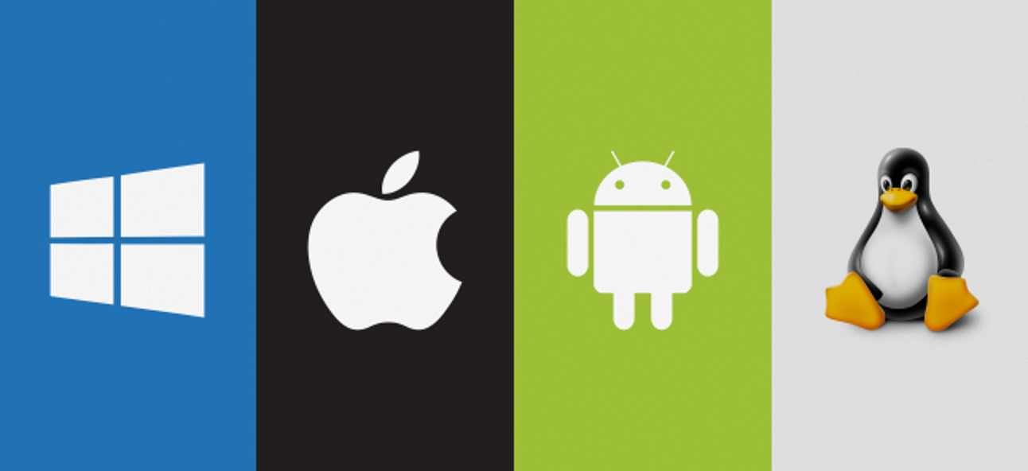

Operating System
Nazneen Akhter
Assistant Professor
Dept. of ICT
Faculty of Science and Technology
Bangladesh University of Professionals (BUP)

Slide 2
Storage Structure
Main memory – only large storage media that the CPU can access directly
  Random access
  Typically volatile
Secondary storage – extension of main memory that provides large nonvolatile storage capacity
Hard disks – rigid metal or glass platters covered with magnetic recording material
  Disk surface is logically divided into tracks, which are subdivided into sectors

Slide 3
Storage Structure (Cont.)
Solid-state disks – faster than hard disks, nonvolatile
  Various technologies
  Becoming more popular
Caching – copying information into faster storage system; main memory can be viewed as a cache for secondary storage
Device Driver for each device controller to manage I/O
  Provides uniform interface between controller and kernel

Slide 4
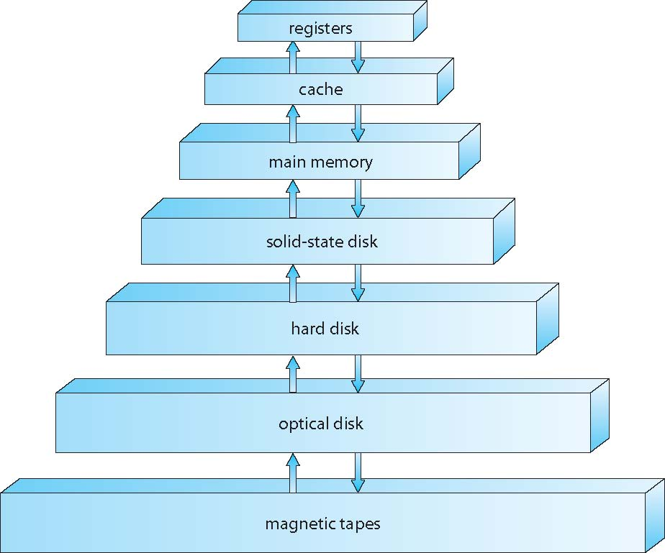
Storage-Device Hierarchy
Storage systems organized in hierarchy
  Speed
  Cost
  Volatility

Slide 5
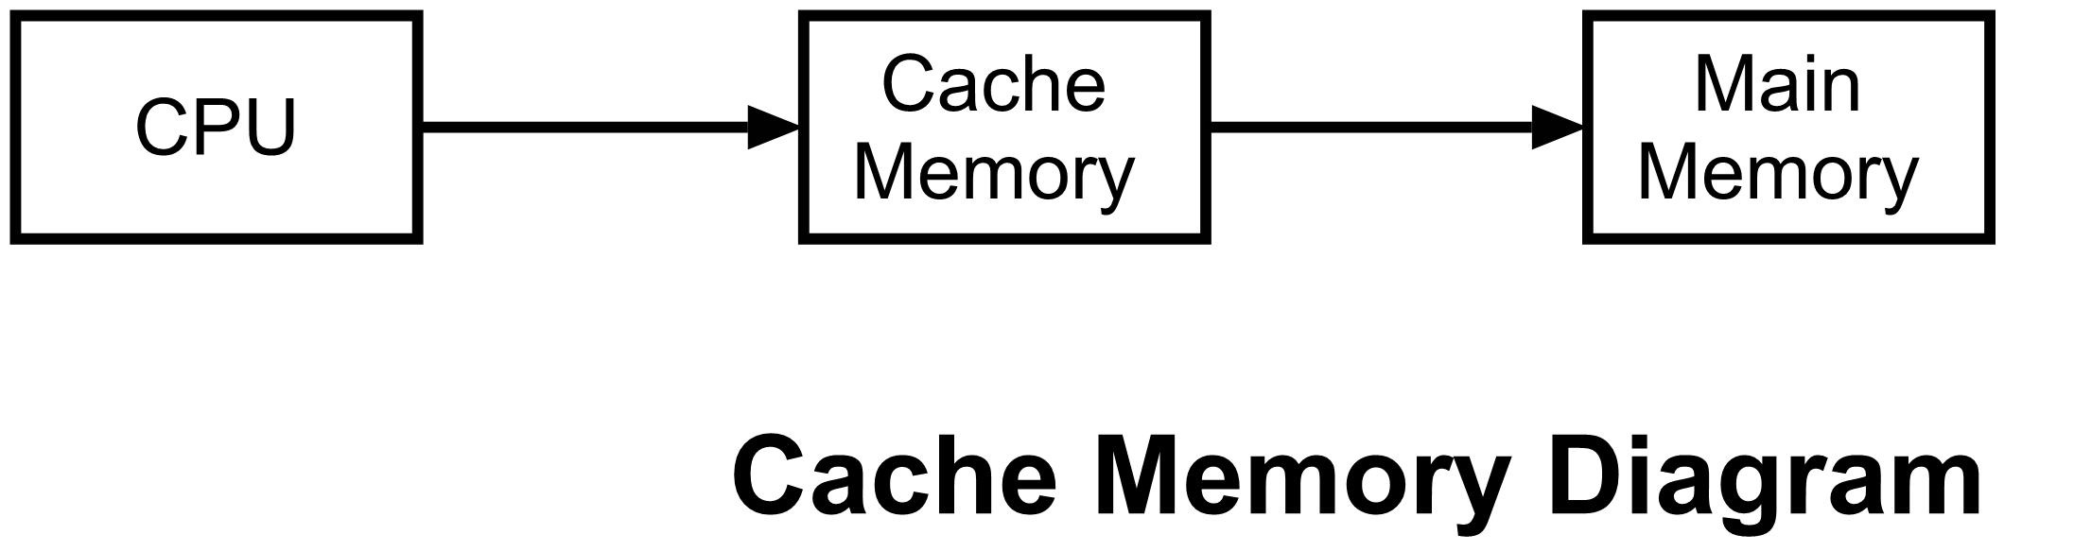
Caching
Information in use copied from slower to faster storage temporarily
Faster storage (cache) checked first to determine if information is there
  If it is, information used directly from the cache (fast)
  If not, data copied to cache and used there
Cache smaller than storage being cached
  Cache management important design problem
  Cache size and replacement policy

Slide 6
Direct Memory Access (DMA)
It is a sub controller that can access memory in sequential order without intervention from the processor
It is used to moving around large amounts of data in the computer without taking time away from the processor.

Slide 7
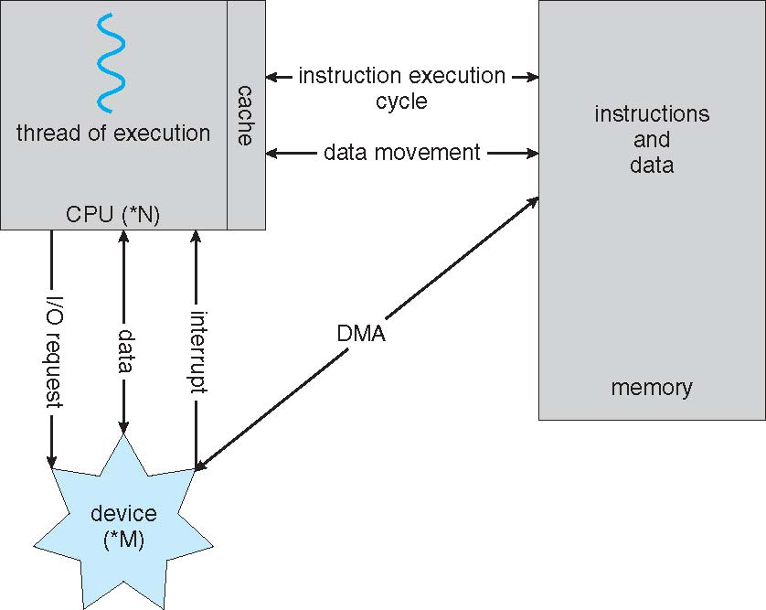
Direct Memory Access (DMA) Structure

Slide 8
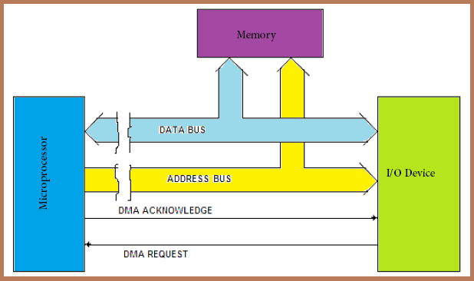

Slide 9
Working principal of DMA controller: DMA controller is used with the microprocessor. Which helps to generate the addresses for the data to be transferred from the I/O devices.
First step, the peripheral device sends the request signal (DMARQ) to the DMA controller.
Second step, the DMA controller in turn passes it to the microprocessor (HOLD signal).
Third step, on receipt of the DMA request, the microprocessor sends an acknowledge signal (HLDA) to the DMA controller.
Fourth step, on receipt of this signal (HLDA), the DMA controller sends a DMA acknowledge signal (DMACK) to the I/O device.
Fifth step, the DMA controller then takes over the control of the buses of microprocessor. And it take controls the data transfer between RAM and I/O device.
Sixth and Final Step, when the data transfer is completed, DMA controller returns the control over the buses to the microprocessor by disabling the HOLD and DMACK signals.

Slide 10
Use of DMA Controllers
2. DMA controller requests transfer to memory
RAM
DMA controller
Bus control logic
4. ACK
5. Interrupt when done
Processor
Storage
1. CPU sets up a memory transaction on the DMA controller
3. Data is transferred

Slide 11
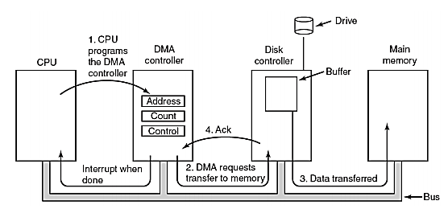

Slide 12
Thank You…

